Slide 1
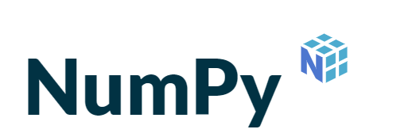
Chapter 4 – Numpy
2025-2026

Slide 2
Overview
Creating a NumPy array
Properties of a NumPy array
Arithmetic operations
Extracting specific items from an array
Creating a new array from an existing array
Reshaping and flattening multidimensional arrays
Filtering arrays
Aggregations
Read csv file into NumPy array

Slide 3
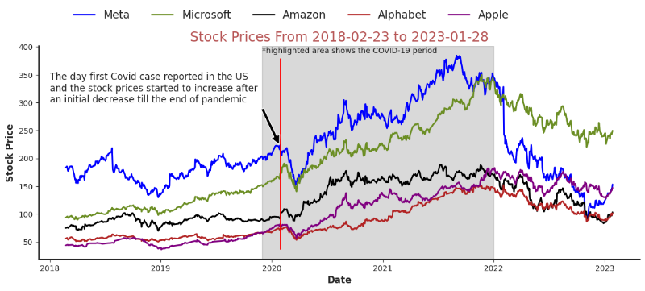


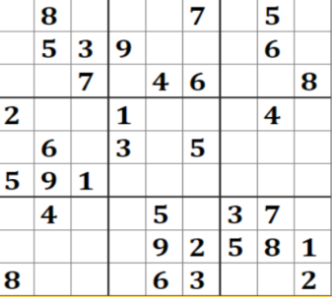
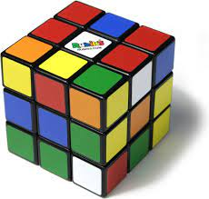
NumPy
Numeric Python
Open-source extension for working with arrays in Python
Remember: basic Python only uses lists (or tuples or sets or dicts), not arrays
Arrays are of fixed size and contain only 1 datatype
An array can be multidimensional
Some examples of 1D/2D/3D arrays:

Slide 4
What’s wrong with lists?
When you’ve used lists you’ve gotten used to very flexible programming
Add items, remove items, multiple datatypes, …
You’ll feel reluctant to let this flexibility go and when doing ‘normal’ Python programming the difference between a list and a np-array isn’t that big
But when you start doing AI you will feel the difference:
Dijkstra algorithm is a way finding the path through a maze
For this you need to try every single path there is
As a result, you go over the maze a lot
But NumPy won’t solve everything:
Arrays have one data type: you can’t store name, age and sex together in a np-array
The fix: Pandas dataframes
These are actually combined np-arrays

Slide 5
Install and import NumPy
Run the install command in a terminal window:
pip install numpy
In Jupyter you must use a preceding ! to force the code cell to be executed in a terminal window: !pip install numpy
To import numpy we usually import it with a shorter name since it's used so much: import numpy as np

Slide 6


Creating a NumPy array
Via the function array() you create an array object.
The first argument is a list or tuple. The number of elements in this list or tuple determines the size of the array.
The second optional argument specifies the type of the elements.
If this argument is not given, Python determines the type itself.
import numpy as np
# create a 1d array from a list list1 = [0, 1, 2, 3, 4]
arr1d = np.array(list1)
# create a 2d array from a list of lists and datatype float
list2 = [[0, 1, 2], [3, 4, 5], [6, 7, 8]] arr2d_float = np.array(list2, dtype='float')

Slide 7
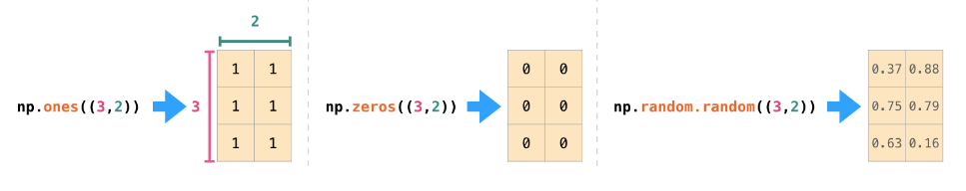
Creating a NumPy array
With the np methods ones(), zeros(), full(), random.random() an array of desired shape with initialized values can be created
6
6
np.full((3,2),6)
6
6
6
6
Notes:
NumPy full() is used in exercise 2. array = np.full((3,5),fill_value=2) creates an array of 3 rows and 5 columns where every cell equals 2

Slide 8
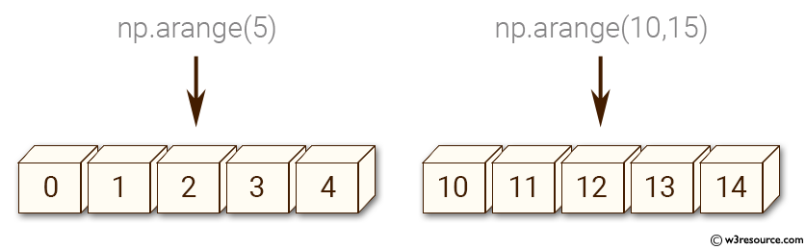
Creating a NumPy array
With the np method arrange() a sequence of numbers can be handled as a 1-dimensional array

Slide 9
Properties of a NumPy array
3
.ndim = 2
.shape = (4,3) .shape[0] = 4 .shape[1] = 3
.dtype = int32
.size = 12 → 4*3
1 | 2 | 3
4 | 5 | 6
7 | 8 | 9
10 | 11 | 12
4

Slide 10
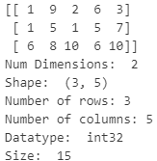
Properties of a NumPy array
# create a 2d array with 3 rows and 5 columns
# initialized with random integers from 1 to 10
arr = np.random.randint(1,11,(3,5))
print(arr)
# ndim
print('Num Dimensions: ', arr.ndim)
# shape
print('Shape: ', arr.shape)
# number of rows
print('Number of rows:',arr.shape[0])
# number of columns
print('Number of columns:',arr.shape[1])
# dtype
print('Datatype: ', arr.dtype)
# size
print('Size: ', arr.size)

Slide 11
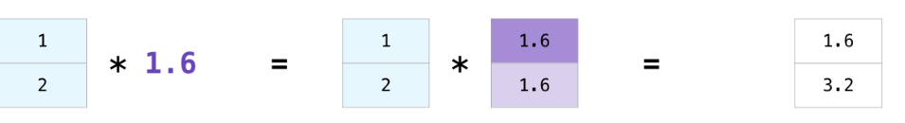
Arithmetic operations
There are often cases when you want to carry out an operation between an array and a single number (you can also call this an operation between a vector and a scalar).
Say, for example, an array represents the distance in miles, and you want to convert it to kilometers. You can simply say data * 1.6:
See how NumPy understood that operation to mean that the multiplication should happen with each cell. That concept is called broadcasting.

Slide 12
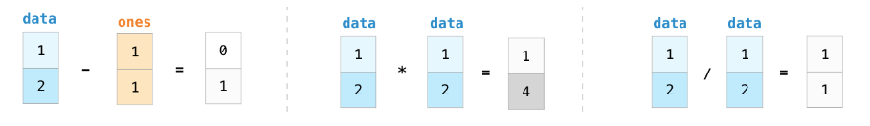
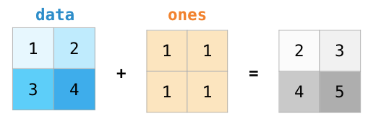
Arithmetic operations
You can add and multiply matrices using arithmetic operators (+-*/) if the two matrices are the same size. NumPy handles those as position-wise operations:

Slide 13
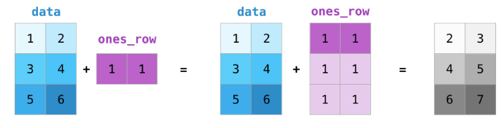
Arithmetic operations
NumPy broadcasting is a mechanism that enables element-wise operations on arrays of different shapes by automatically "stretching" the smaller array along the appropriate dimensions to match the larger array's shape, all without creating unnecessary copies of the data.
This process requires that the array dimensions are compatible, meaning they are either equal or one of them is 1 (i.e. has just one row or one column)

Slide 14
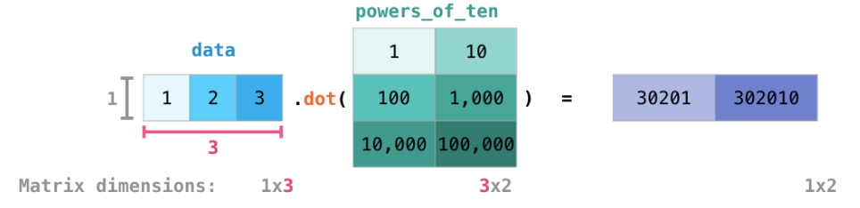
Arithmetic operations
A key distinction to make with position-wise arithmetic is the case of matrix multiplication using the dot product.
NumPy gives every matrix a dot() method to carry-out dot product operations with other matrices

Slide 15
Extracting specific items from an array
arr[ 2 , 1]
arr[1:4]
arr[ :3 , :2]
0
1
2
0
1
2
0
1
2
0
1 | 2 | 3
4 | 5 | 6
7 | 8 | 9
10 | 11 | 12
0
1 | 2 | 3
4 | 5 | 6
7 | 8 | 9
10 | 11 | 12
0
1 | 2 | 3
4 | 5 | 6
7 | 8 | 9
10 | 11 | 12
1
1
1
2
2
2
3
3
3

Slide 16
Creating a new array from an existing array
When assigning a part of an existing array to a new array, in memory you just created a reference to the parent array.
This means that every action taken in the new array reflects in the parent array.
arr_new = arr[ :3 , :2]
1 | 2 | 3
4 | 5 | 6
7 | 8 | 9
10 | 11 | 12
10 | 2 | 3
4 | 5 | 6
7 | 8 | 9
10 | 11 | 12
arr_new[0,0]= 10
10 | 2
4 | 5
7 | 8
arr
arr

Slide 17
Creating a new array from an existing array
To create an entire new array object, use the method copy()
Both arrays now live independently from each other
arr_new = arr[ :3 , :2].copy()
1 | 2 | 3
4 | 5 | 6
7 | 8 | 9
10 | 11 | 12
arr_new[0,0]= 10
1 | 2 | 3
4 | 5 | 6
7 | 8 | 9
10 | 11 | 12
10 | 2
4 | 5
7 | 8
arr
arr

Slide 18
Creating a new array from an existing array
NumPy where() function is used to create a new array from the existing array based on conditions.
It returns the indices of the array for which each condition is True. So, you get an indication of whether or not to keep the element in the corresponding array.
You can use the result for boolean mask slicing.
For example, if you filter the array [1, 2, 3] with the boolean list [True, False, True], the filtered array would be [1, 3].

Slide 19
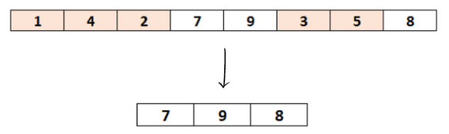

Creating a new array from an existing array
# Create a numpy array
arr = np.array([1, 4, 2, 7, 9, 3, 5, 8])
# indexes of elements to keep
indexes_to_keep = np.where(arr > 5)
print(indexes_to_keep)
# filter the array
arr_filtered = arr[indexes_to_keep]
# show the filtered array
print(arr_filtered)
Notes:
https://datascienceparichay.com/article/filter-numpy-array-with-examples/

Slide 20
Creating a new array from an existing array
np.where (conditions, x, y)
The where() function has 2 optional extra parameters x and y.
If condition holds true, the new array will choose elements from x.
Otherwise, if it’s false, elements from y will be taken.
With that, our final output array will be an array with elements from x wherever condition = True, and elements from y whenever condition = False.
Although x and y are optional, if you specify x, you MUST also specify y.
The output array shape must be the same as the input array.

Slide 21

Creating a new array from an existing array
# Create a numpy array
arr = np.array([1, 4, 2, 7, 9, 3, 5, 8])
# filter the array
arr_filtered = np.where(arr > 5, arr,0)
# show the filtered array
print("arr:",arr)
print("arr_filtered:",arr_filtered)
0 | 0 | 0 | 7 | 9 | 0 | 0 | 8

Slide 22
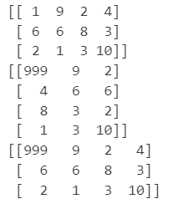
Reshaping and flattening multidimensional arrays
Reshaping means changing the shape of an array
# create a 2d array with 3 rows and 4 columns
arr = np.random.randint(1,11,(3,4))
print(arr)
# reshape a 3x4 array to 4x3 array
arr_reshaped = arr.reshape(4, 3)
# every change in the reshaped array is # reflected in the parent (base)
arr_reshaped[0,0]=999 print(arr_reshaped) print(arr)
arr
arr_reshaped
arr

Slide 23

Reshaping and flattening multidimensional arrays
Flattening an array means converting a multidimensional array into a 1D array.
3 methods available:
reshape(-1): returned array is reference
flatten(): a new 1D array object is created
ravel(): the returned 1D array is just a reference to the parent array

Slide 24

Selecting unique values: unique()
Suppose we have the data of 2 tests:
What are the unique values in each of these datasets? print(np.unique(test_1), np.unique(test_2), sep='\n’)
How many times do these unique values occur in dataset test_1?
unique, counts = np.unique(test_1, return_counts=True)
print(unique, counts )

Slide 25
Selecting shared values: intersect1d()
And which numbers do the two tests share?
print(np.intersect1d(test_1, test_2))

Slide 26
Aggregations
When faced with a large amount of data, a first step is to compute summary statistics for the data in question. This can be done with aggregate functions that perform a calculation on a set of values and return a single value.
The most common summary statistics are the mean, the median, the minimum and the maximum value in a dataset.
A data scientist also wants to know how spread-out the numbers in the dataset are by computing percentiles and the standard deviation.
Other aggregates like sum and product could be useful as well.

Slide 27
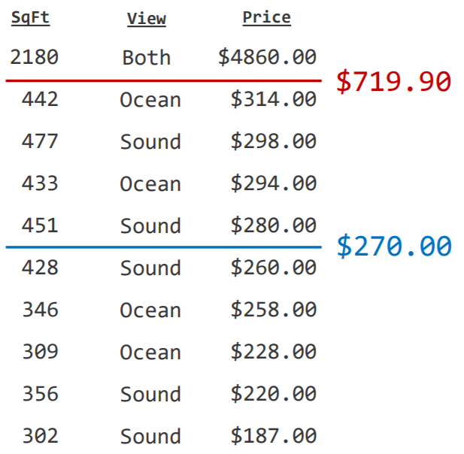
Aggregations: mean versus median
E.g. hotel room prices
Due to the extremely high price of the suite mean and median are far apart
In this case median is a far better tendency indicator than average.
The average is pulled upwards by the one high rental price.
We say: an outlier skews the data.
mean
median

Slide 28
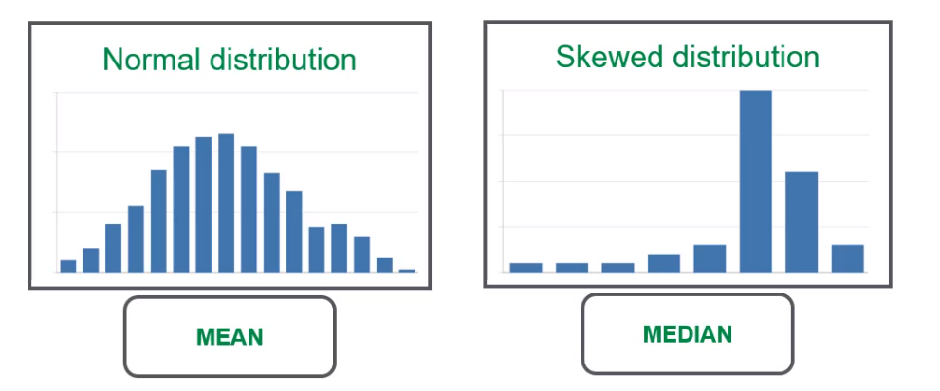
Aggregations: mean versus median
In general, outliers have a major effect on the mean but they don’t have such an effect on the median. Therefore, in a skewed distribution the median gives a more realistic picture of the data.

Slide 29
Aggregations: percentiles and fractiles
Percentile is the value below which a stated percentage of the observations lie when all the values are sorted from least to greatest.
Example: If 64 out of 80 students score less than 70 points on a test, then 70 points is the 80% percentile, i.e. 80% of the students (64/80*100) have grades below 70 points. The 80% percentile is written as P80.
Notes:
Percentiles are the values that divide a distribution into 100 equal parts.
Quantiles and fractiles are essentially the same. They refer to dividing a sample or probability distribution into equal-sized, adjacent subgroups or areas of equal probability. The median, quartiles, deciles, percentiles, and other partition values are collectively called quantiles or fractiles. All quantiles are percentages, and they can be expressed as quartiles, deciles, or percentiles by expressing the decimal or fraction α in terms of quarters, tenths, or hundredths respectively.

Slide 30
Aggregations: percentiles and fractiles
There are 3 special percentiles called the quartiles, which divide the data into four groups of equal size.
The first quartile (Q1) is the same as the 25th percentile or 0.25-fractile. This number indicates that 25% of the observations are below this number.
The second quartile (Q2) is the 50th percentile or the 0.50-fractile and thus equal to the median.
The third quartile (Q3) equals the 75th percentile or 0.75-fractile.
Be aware that there is no fourth quartile!

Slide 31
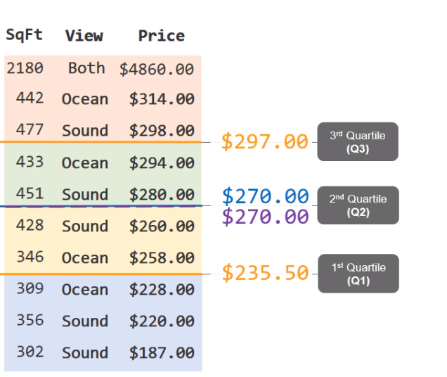
Aggregations: percentiles and fractiles
The dataset is split into 4 groups
Q3 = P75
Q2 = P50 = Median
Q1 = P25

Slide 32


Wrong?!?
The quartiles as calculated on the previous slide aren’t entirely correct according to the formula you might have learned earlier
That’s because there are 9 ways to calculate a quartile:
https://robjhyndman.com/publications/quantiles/
Quantiles and Percentiles, Clearly Explained!!! - YouTube
If you ever take a master course in statistics: dive deep into all 9 of them
By default np.percentile() uses the method ‘linear’
In this class: whatever Python tells you is correct
Notes:
numpy.percentile — NumPy v1.26 Manual

Slide 33
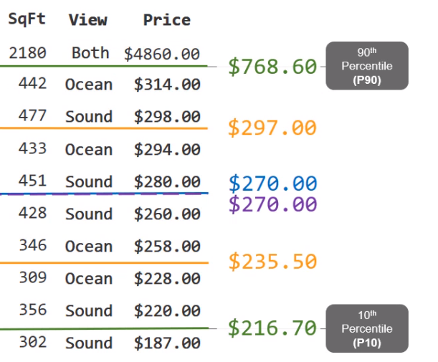
Aggregations: percentiles and fractiles
Next to the quartiles other percentiles like P10 and P90 can be calculated.
Values not in the 0,90-fractile or in the 0,10-fractile could be seen as outliers.

Slide 34
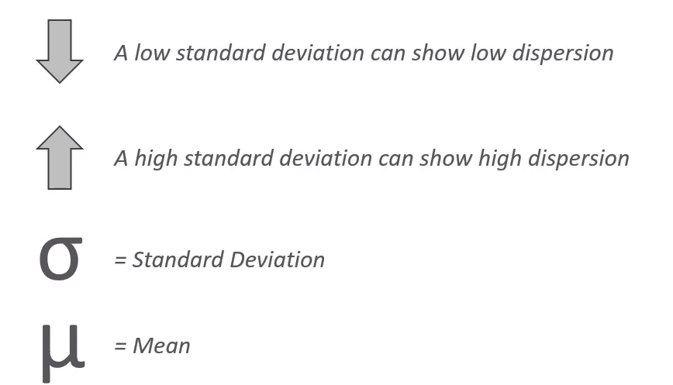
Aggregations: standard deviation
Standard deviation measures the dispersion of a data population in a normal distribution.
Notes:
Standard deviation is presented by the Greec letter sigma
The mean by the greec letter mu
The Standard Deviation is a measure of how spread out numbers are. Standard deviaton is the square root of the Variance Variation is the average of the squared differences from the Mean.
Show: https://www.mathsisfun.com/data/standard-deviation.html

Slide 35
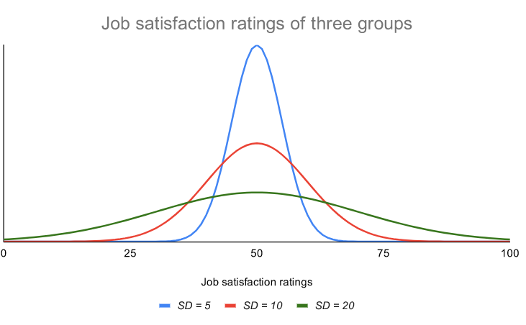
Aggregations: standard deviation
The curve with the lowest standard deviation has a high peak and a small spread, while the curve with the highest standard deviation is more flat and widespread.

Slide 36
Aggregations: standard deviation
The empirical rule, or the 68-95-99.7 rule, tells you where your values lie:
Around 68% of scores are within +/-1 standard deviation of the mean,
Around 95% of scores are within +/- 2 standard deviations of the mean,
Around 99.7% of scores are within +/- 3 standard deviations of the mean.

Slide 37
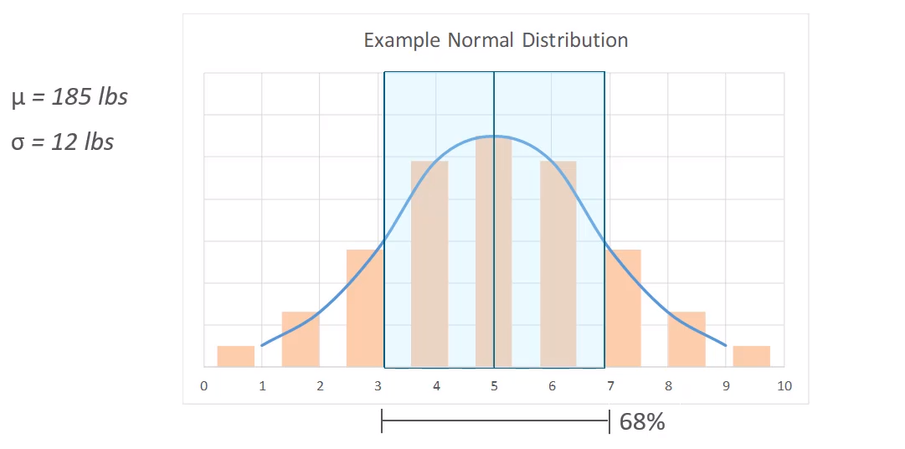

Aggregations: standard deviation
of all data is covered in this range
Notes:
Lbs = pounds
+/- 1 standard deviation away from the mean covers all values from 173 to 197 and covers 68% of all data points
The empirical rule, or the 68-95-99.7 rule, tells you where your values lie:
Around 68% of scores are within +/-1 standard deviations of the mean,
Around 95% of scores are within +/- 2 standard deviations of the mean,
Around 99.7% of scores are within +/- 3 standard deviations of the mean.

Slide 38
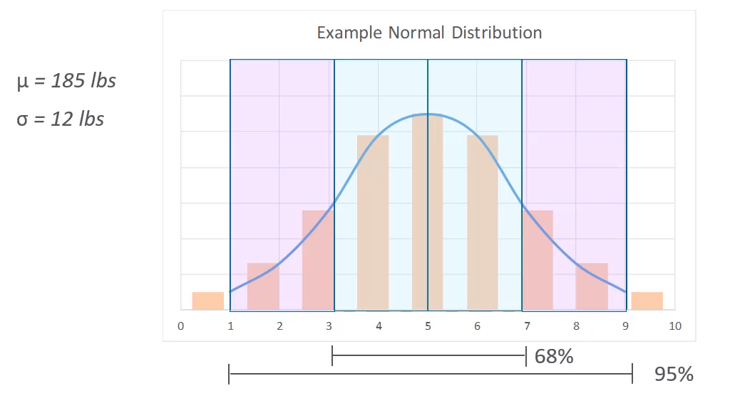

Aggregations: standard deviation
of all data is covered in this range
Notes:
Lbs = pounds
+/- 2 standard deviation away from the mean covers all values from 161 to 209 lbs and covers 95% of all data points

Slide 39
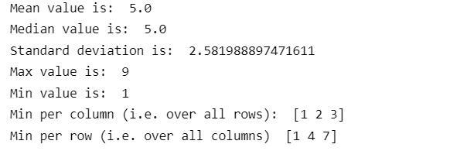
Aggregations: min, max, mean, median, std
axis = 1
# mean, median, max and min
print("Mean value is: ", arr.mean())
print("Median value is: ", np.median(arr))
print("Standard deviation is: ", arr.std())
print("Max value is: ", arr.max())
print("Min value is: ", arr.min())
# row wise and column wise min
# row wise and column wise min
print("Min per column", arr.min(axis=0))
print("Min per row", arr.min(axis=1))
axis = 0
1 | 2 | 3
4 | 5 | 6
7 | 8 | 9

Slide 40

Aggregations: sum
#sum
print("Sum all items is: ", arr.sum())
print("Sum all items per column (i.e. over all rows): ", arr.sum(axis=0))
print("Sum all items per row (i.e. over all columns): ", arr.sum(axis=1))
axis = 1
axis = 0
1 | 2 | 3
4 | 5 | 6
7 | 8 | 9

Slide 41

Aggregations: percentiles and fractiles
#array with hotel room prices
prices = np.array([187.00,220.00,228.00,258.00,260.00,280.00,294.00,298.00,314.00,4860.00])
#Find the quartiles (25th, 50th, and 75th percentiles) of the array
print(np.percentile(prices, [25, 50, 75]))
#find the 90th percentile of the array
print('90% of the room prices are lower than',round(np.percentile(prices, 90),2), '$')

Slide 42
Read csv file into NumPy array
To load data in a csv into an array, numpy has several built-in functions:
no missing values: numpy.loadtxt(fname, delimiter, …) more info: https://numpy.org/doc/stable/reference/generated/numpy.loadtxt.html
missing values: numpy.genfromtxt(fname, delimiter, filling_values,…) more info: https://numpy.org/doc/stable/reference/generated/numpy.genfromtxt.html#

Slide 43
Summary
We’ve covered a lot of ground, but much of it was mainly new ways to code stuff
Creating numpy arrays, getting the properties, performing mathematical operations, extracting items, creating new arrays, reshaping and flattening them, read into a file
These you can look up easily if you know what you want to achieve
Practice using them!
We’ve also covered some theoretical concepts
Mean, average, skewing, standard deviation
No amount of AI is going to help you on an exam if you don’t grasp these concepts

